Slide 1
Overview of Hardware

Slide 2
Overview
Hardware
Processor
Memory
I/O devices
Interrupts

Slide 3
Processor (CPU)
CPU executes a set of instructions
Different for different CPU architectures
Various memory and register-based instructions
Anatomy of a CPU
Program Counter (PC): holds address of next instruction
Instruction Register (IR): holds instruction being executed
General Registers (Reg. 0..n): hold variables
Stack Pointer (SP): holds address for accessing stack
Status Register (SR): holds control bits that affect program execution, also called processor status word

Slide 4
CPU Execution
All a CPU does is Fetch/Decode/Execute
PC = <start address>
while (halt flag not set) {
IR = memory[PC]; // read from mem
PC = PC + 1;
execute(IR); // decode & execute instruction
// uses registers, stack pointer,
// status register, etc.
}

Slide 5
Memory
Memory (DRAM) provides storage
Think of it as an array of bytes
Each byte has unique address
Nr. of bits that represent address is called the address width
Example: 32-bit, 64-bit CPUs
Simple abstraction
Write(address, value)
value = Read(address), returns last value written
byte
7
12
6
5
5
34
4
0
3
5
2
4
1
3
0
5
address value

Slide 6
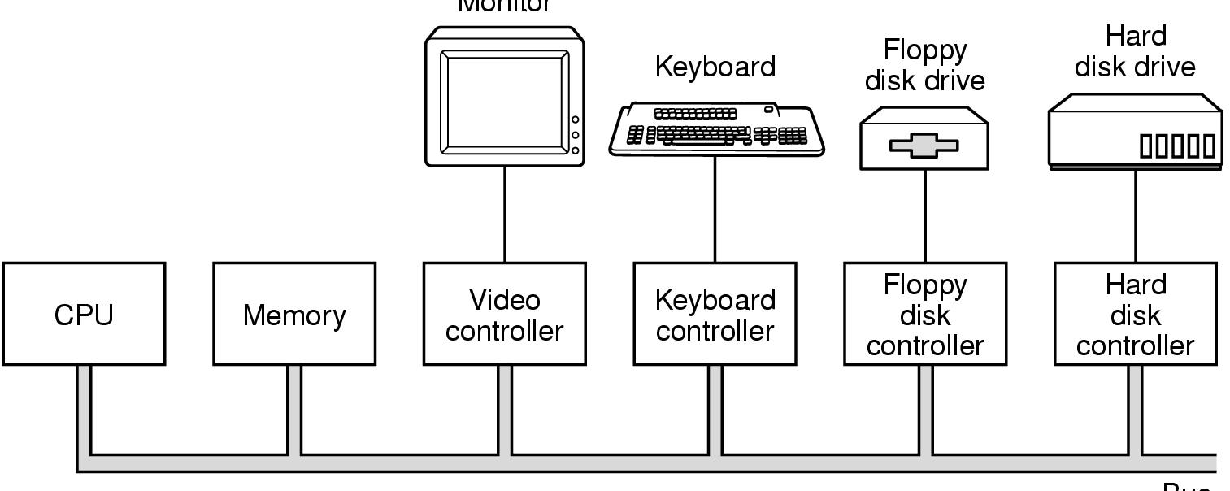
I/O Devices
Devices are connected to device-specific controllers
One or more buses connect the CPU to memory and to device controllers
Monitor
Bus
Notes:
The bus is a shared medium. A bus arbiter ensures that a device has exclusive access to the bus when it sends a message.

Slide 7
How does CPU Communicate With Devices?
Each controller owns a range of "bus" addresses
CPU communicates with controller by sending message to address using
Special I/O instructions, or
Memory-mapped I/O
Certain memory locations are mapped to device registers
CPU reads/writes these memory locations

Slide 8
Communicating with Devices
Communication model
Send(address, value)
CPU writes value to an address
value = Receive(address)
CPU will poll (continuously read) address for a value to determine whether data is available
Then read the data using another address
Is this model similar to the memory abstraction?
How often should we poll the device?
Keyboard device, high-speed n/w device
Notes:
Is this model similar to the memory abstraction? Model seems similar to memory, but data may never arrive, be corrupted or arrive out-of-order
Poll: should poll roughly based on data arrival frequency. Faster polling wastes CPU, with slower polling, arriving data will be delayed or might be dropped.

Slide 9
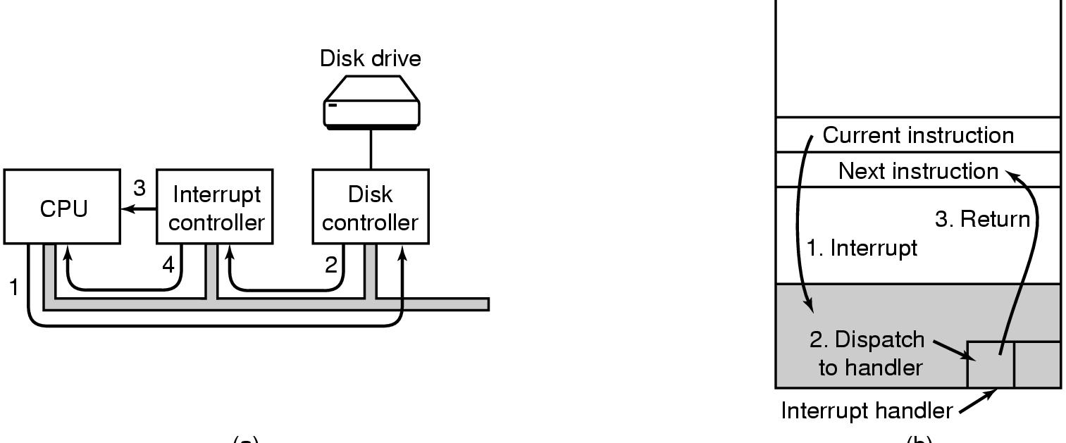
Interrupts
Polling is not efficient
CPU and devices can run concurrently more efficiently if the device can send an interrupt signal to the CPU when it is done
CPU has an “interrupt request” flag that can be set by devices
send
Notes:
Analogy – phone ring

Slide 10
Processor Execution with Interrupts
Step 1: When interrupt flag is set
H/W saves PC
Sets PC to a predetermined address, containing code called interrupt handler
Step 2: When h/w executes next instruction, interrupt handler code runs
Saves CPU registers of interrupted program, why?
Runs code to handle device event
Restores CPU registers of interrupted program
Step 3: Handler runs “return from interrupt” instruction
Sets PC to the original next instruction of interrupted program
Result: interrupt handling looks like a function call, can occur at any time, but program is unaware it occurred
Notes:
Step 1 in h/w: recall PC contains address of next instruction of interrupted program
Step 2 and 3 in software
Why is save and restore processor context done: since handling of device event can clobber registers, we need to save these registers so that when we rerun the interrupted program, it can continue running

Slide 11
Processor Execution with Interrupts
PC = <start address>
while (halt flag not set) {
IR = memory[PC]; // read from mem
PC = PC + 1;
execute(IR);
if (InterruptRequest) {
hardware saves previous PC, SP, SR;
PC = memory[0]; // address 0 contains code of
// intr. handler
}
}
Interrupt_handler() {
save_processor_state();
handle_interrupt();
restore_processor_state();
return from interrupt; // restores prev PC, SP, SR
}

Slide 12
Summary
These slides provide an overview of computer h/w
CPU: executes instructions
Memory: array of bytes, used to store code and data
I/O devices: run concurrently with CPU
CPU requests service from device
CPU can poll to check when device has finished serving request
Interrupts
Allow CPU to do useful work until device is done with request
Interrupt handling requires support from h/w and software

